Slide 1



Advancing IFB Community Banking, MSME & Retail Finance
Building the Backbone for Startups, Entrepreneurs and Inclusive Economic Growth in Ethiopia
Prepared by Muktar Hadji
Head of Interest free banking- IHSAN
Siinqee Bank
IHSAN
ADVANCING INCLUSIVE ISLAMIC FINANCE
01

Slide 2

Connecting Global Expertise with Africa's Emerging Islamic Finance Markets
Accelerating ethical finance, Shariah-compliant solutions, regulatory integration, and sustainable economic growth across Africa.
August 17, 2026 Addis Ababa, Ethiopia Patroned by National Bank of Ethiopia

Slide 3
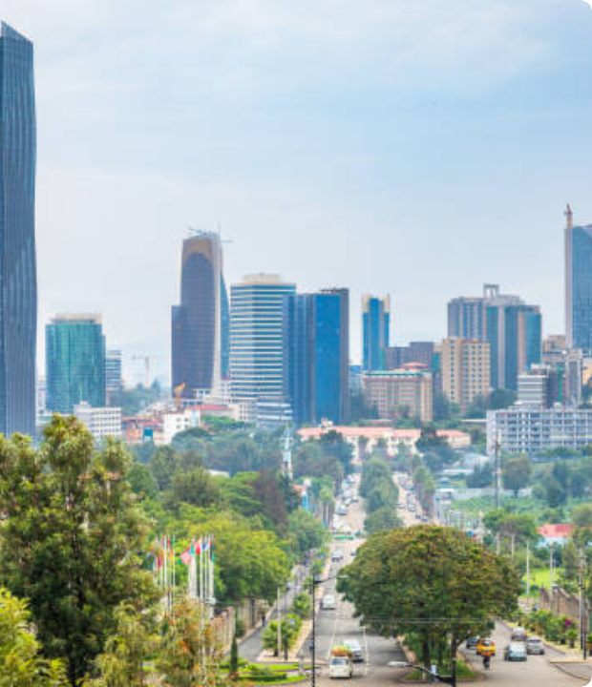
Ethiopia: Gateway for Interest free banking- Ethical Finance
Financial Sector Reforms
Under the patronage of the National Bank of Ethiopia, sweeping reforms are enabling full-fledged interest-free banks, takaful operators, and capital market instruments to thrive alongside conventional banking systems.
With the opening of the Ethiopian Securities Exchange and expanding digital financial channels, Addis Ababa is emerging as East Africa's leading hub for Shariah-compliant finance and investment.

Slide 4

Expanding Market Horizon
60M+
Substantial Financial Inclusion Drive
Interest-free financial solutions are rapidly transitioning from a niche offering into one of the primary catalysts for banking expansion across Country. With growing regulatory support, these non-interest financial products provide essential tools to integrate unbanked populations into the formal economic system.
Unbanked Population in Ethiopia

Slide 5
Expanding Market Horizon
60M+
Substantial Financial Inclusion Drive
Interest-free financial solutions are rapidly transitioning from a niche offering into one of the primary catalysts for banking expansion across Country. With growing regulatory support, these non-interest financial products provide essential tools to integrate unbanked populations into the formal economic system.
Unbanked Population in Ethiopia

Slide 6



Ethiopia’s Inclusive Growth Opportunity
Position Islamic finance as a mainstream instrument of real-economy inclusion.
Ethiopia's economic trajectory requires moving beyond basic financial access to productive finance that fosters active entrepreneurship and sustainable wealth creation.
Move Beyond Account Ownership: Focus on meaningful utilization and growth.
Expand Productive Finance: Target micro-enterprises, startups, and agricultural units.
Connect to Real Activity: Link financial supply directly to trade, manufacturing, and services.
IHSAN
ADVANCING INCLUSIVE ISLAMIC FINANCE
02

Slide 7



Addressing the Financial Inclusion Gap
Access vs Impact
Institutional Base
Formal financial access has expanded, but basic access does not automatically create productive capital deployment.
Around 32 commercial banks and 50+ MFIs provide a broad foundation, many more SACCOs are engaging, and most of them are offering IFB, yet key economic sectors and mass community remain underserved.
Rapid Digital Shift
The Core Challenge
Digital payments and Interest-Free Banking are expanding rapidly across urban and rural demographics, but does not reaching real user targets
Reaching low-income households, startups, and MSMEs with appropriate, Shariah-compliant, sustainable finance.
Financial Accounts
Active Usage
Productive Finance
Enterprise Growth
Economic Impact
IHSAN
ADVANCING INCLUSIVE ISLAMIC FINANCE
03

Slide 8



Why Interest-Free Banking Matters
Real-Economy Financing Paradigm
Islamic finance is not merely an alternative to interest-based banking; it provides an asset-backed, risk-sharing model inherently tied to tangible productivity.
IFB seamlessly combines strict Shariah compliance with a transformative financial-inclusion proposition for emerging economies.
Core Shariah Principles
Prohibition of Riba (interest), excessive Gharar (uncertainty), and Maysir (gambling); emphasis on trade, asset linkage, fairness, and transparency.
REAL ASSET LINKAGE & ETHICAL BANKING
Financing connects directly to physical trade, equipment acquisition, agricultural cycles, manufacturing, and equity partnerships.
IHSAN
ADVANCING INCLUSIVE ISLAMIC FINANCE
04

Slide 9









The IFB Financing Toolkit
A versatile set of Shariah contracts tailored to serve distinct stages of customer and enterprise lifecycles:
Murabaha
Ijarah
Musharakah
Mudarabah
Salam & Istisna
Cost-plus trade, inventory, working capital & asset purchasing.
Leasing machinery, vehicles, tools & commercial equipment.
Partnership capital with shared risk and profit distribution.
Entrepreneur finance combining capital & management skill.
Advance purchase for agriculture, manufacturing & construction.
IHSAN
ADVANCING INCLUSIVE ISLAMIC FINANCE
05

Slide 10

Community Banking: The Missing Link
Bringing Banking to the Grassroots
True financial inclusion happens where people live, work, and conduct daily economic activities.
Localized Engagement Model
Multi-Channel Reach: Utilize physical branches, agent networks, and mobile access.
Empowering micro-merchants and rural farming communities through tailored small-ticket financing products.
Institutional Alignment: Partner with local cooperatives, associations, and merchant groups.
Proximity + Trust + Knowledge + Small-Ticket Finance
High Trust Factor: Blend physical proximity with modern digital scalability.
IHSAN
ADVANCING INCLUSIVE ISLAMIC FINANCE
06

Slide 11


MSMEs: Shifting to Cash-Flow Underwriting
Moving Beyond Brick-and-Mortar Collateral
MSMEs struggle with traditional banking due to lack of formal land titles or credit history. IFB offers a relationship-driven alternative.
Alternative Data Integration: Evaluate utility bills, mobile payments, and merchant transaction flows.
Business Viability: Assess actual trade turnover and cash flow strength instead of passive assets.
Lifecycle Relationship: Structure financing around continuous business milestones.
Cash Flow + Transaction History + Alternative Data = Viable Risk
IHSAN
ADVANCING INCLUSIVE ISLAMIC FINANCE
07

Slide 12





The IFB Enterprise Financing Ladder
A structured progression pathway supporting clients as they scale from basic financial entry to equity partnership:
01
02
03
04
05
Financial Entry
Micro-Enterprise
MSME Growth
Expansion
Partnership
Savings, basic accounts, payments & transfers.
Small-ticket working capital & tool purchases.
Structured Murabaha & Ijarah for equipment.
Larger growth capital & commercial facilities.
Musharakah / Mudarabah scalable ventures.
IHSAN
ADVANCING INCLUSIVE ISLAMIC FINANCE
08

Slide 13




Empowering Startups & Innovation
Key Success Enablers
The Entrepreneur Dilemma
Mentorship Integration: Pair financing with technical business development support.
Startups possess high market potential but lack physical collateral and historical financial statements required by traditional banks.
Robust Risk Framework: Tailored governance designed for early-stage evaluation.
Ecosystem Access: Connect startups with wider value chains and corporate buyers.
Partnership Solution
Risk-sharing contracts (Musharakah & Mudarabah) align bank incentives directly with business success, offering growth capital with advisory support.
IHSAN
ADVANCING INCLUSIVE ISLAMIC FINANCE
09

Slide 14



Retail IFB: Beyond Deposit Mobilization
Building holistic, Shariah-compliant relationships that enhance customer financial wellbeing:
Savings & Payments
Asset Financing
Social Wellbeing
Digital Investment
Safe custody (Wadiah) and profit-sharing accounts.
Consumer goods, home construction & vehicle financing.
Education, medical, and seasonal personal needs.
Shariah-compliant investment funds & wealth solutions.
Deposit Account
Active Financial Relationship
Sustainable Financial Wellbeing
IHSAN
ADVANCING INCLUSIVE ISLAMIC FINANCE
10

Slide 15
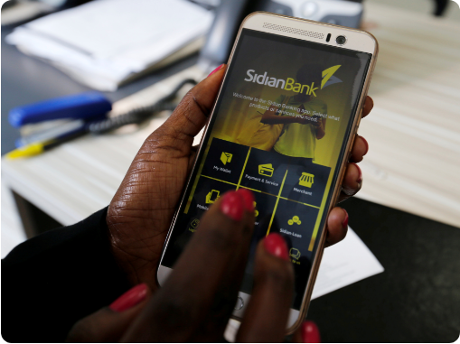

Digital IFB: The Scale Engine
Expanding Reach & Lowering Cost-to-Serve
Digital channels unlock unprecedented scalability for small-ticket financial products without requiring heavy physical branch expansion.
End-to-End Digital Flow:
Onboarding Alternative Scoring Shariah Validation Instant Approval Disbursement
IHSAN
ADVANCING INCLUSIVE ISLAMIC FINANCE
11

Slide 16



Digital Governance & Shariah Integrity
Non-Negotiable Imperative
Technology must digitize the Shariah-compliant transaction — never bypass or compromise its core governance requirements.
Contract Sequencing
Asset Traceability
Fund Segregation
Ensure valid step-by-step execution (Offer, Acceptance, Ownership, Transfer).
Maintain explicit asset identification, supplier proof, and digital documentation.
Guarantee complete ledger separation of IFB funds with clear audit trails.
IHSAN
ADVANCING INCLUSIVE ISLAMIC FINANCE
12

Slide 17






Market Opportunities for IFB Expansion
Underserved Population
Women-Led MSMEs
Agri Value Chains
Massive demand among unbanked communities seeking interest-free solutions.
Growing entrepreneurial activity requiring supportive, non-predatory capital.
Huge seasonal financing potential using Salam and Ijarah equipment contracts.
Digital Payments
Ethical Brand Loyalty
Community Ecosystems
Rapid adoption of mobile wallets creating actionable alternative credit data.
Strong cultural preference for authentic, Shariah-compliant services.
Existing informal networks lowering transaction & acquisition costs.
IHSAN
ADVANCING INCLUSIVE ISLAMIC FINANCE
13

Slide 18



Key Structural Challenges to Address
Liquidity & Risk Concentration
CBS & Digital Constraints
Managing short-term liquidity instruments and avoiding sector-specific concentration risks.
Legacy core banking systems lacking native support for complex IFB contract workflows.
Talent Shortage
Customer Financial Literacy
Need for specialized staff trained simultaneously in Shariah law, credit risk, and digital banking.
Bridging awareness gaps regarding IFB mechanisms, rights, and obligations.
IHSAN
ADVANCING INCLUSIVE ISLAMIC FINANCE
14

Slide 19

Strategic Position of Siinqee Ihsan
Leveraging Our Core DNA
Siinqee Bank’s deep roots in community financing create a unmatched foundation for expanding Interest-Free Banking across Ethiopia.
Extensive Distribution: Unrivaled grassroots branch & agent presence.
Micro Islamic
Microfinance Heritage: Decades of experience serving low-income borrowers.
Transforming microfinance expertise into an engine for inclusive Islamic banking.
Integrated Platform: Combining Retail, MSME, Startup, and Digital IFB.
IHSAN
ADVANCING INCLUSIVE ISLAMIC FINANCE
15

Slide 20

Seven Core Strategic Focus Pillars
Community IFB
MSME Finance
Retail IFB
Startup Finance
Digital Islamic Platform
Agricultural & Value Chain
Graduation Pathways
One Ecosystem — Multiple Customer Journeys — One Inclusive Growth Agenda
IHSAN
ADVANCING INCLUSIVE ISLAMIC FINANCE
16

Slide 21
Agri-Value Chain Financing Model
Unlocking Ethiopia’s Agricultural Potential
Agriculture forms the backbone of Ethiopia's economy. IFB contracts fit seasonal crop yields and equipment investments naturally.
Salam Contracts: Advance purchase financing for crop cultivation inputs.
Ijarah Machinery Leasing: Tractors, irrigation pumps & processing units.
Cooperatives Linkage: Bundling smallholder farmers for aggregate scale.
IHSAN
ADVANCING INCLUSIVE ISLAMIC FINANCE
17

Slide 22






Multi-Stakeholder Partnerships
Building a complete inclusive IFB ecosystem requires collaborative alliances across public and private sectors:
Regulatory & Policy
Telecoms & Fintechs
Producer Cooperatives
National Bank of Ethiopia and government policy institutions.
Mobile operators & tech partners for digital rails.
Farmer unions and trade associations for channel access.
Universities
DFIs & Donors
BDS Providers
Academic institutions for IFB research & talent development.
International development finance institutions for capacity build.
Business development services for entrepreneur incubation.
IHSAN
ADVANCING INCLUSIVE ISLAMIC FINANCE
18

Slide 23





Measuring Holistic Impact
Inclusion
Enterprise
Sustainability
Economy
Shariah
New clients, active accounts & rural reach.
MSMEs funded & jobs created.
Portfolio quality & efficiency.
Asset creation & income growth.
Strict audit & compliance integrity.
IHSAN
ADVANCING INCLUSIVE ISLAMIC FINANCE
19

Slide 24



Three-Phase Strategic Implementation Roadmap
Core Infrastructure
Market Expansion
National Ecosystem
Establish robust Shariah governance & audit.
Roll out community banking networks.
Deploy equity-based Musharakah investments.
Scale MSME small-ticket financing.
Develop core IFB product suite.
Launch digital IFB mobile channels.
Expand full-scale digital financing ecosystem.
Upgrade tech & CBS core capabilities.
Formalize key strategic partnerships.
Drive nationwide inclusive economic impact.
Train specialized staff & field teams.
IHSAN
ADVANCING INCLUSIVE ISLAMIC FINANCE
20

Slide 25





Strategic Proposition
Customer-Centric Focus
Graduation Pathways
Shift from rigid product pushing to holistic, client-centered financial inclusion solutions.
Build long-term advisory relationships that guide micro-clients into scalable commercial entities.
Real Economic Catalyst
Market Leadership
Transform financial resources directly into productive, job-creating business activities.
Position Siinqee Ihsan as Ethiopia’s primary engine for inclusive Islamic economic growth.
IHSAN
ADVANCING INCLUSIVE ISLAMIC FINANCE
21

Slide 26
“The future of Islamic finance should be measured not only by portfolio size, but by the people and businesses it enables to participate, grow and prosper in the real economy.”
“Financial institution should posses legal and moral responsibility moving beyond self satisfying financial performance success – to insure financial inclusion through interest free banking and finance”
Thank you for your commitment to building an inclusive economic future for Ethiopia.
www.siinqeebank.com.et
ihsan@siinqeebank.com.et
IHSAN
ADVANCING INCLUSIVE ISLAMIC FINANCE
22

